Slide 1

Python for Data Science Review
EDA on Datasets

Slide 2

Netflix Movies and TV Shows Dataset
About this Dataset: Netflix is one of the most popular media and video streaming platforms. They have over 8000 movies or tv shows available on their platform, as of mid-2021, they have over 200M Subscribers globally. This tabular dataset consists of listings of all the movies and tv shows available on Netflix, along with details such as - cast, directors, ratings, release year, duration, etc.
What columns does the dataset contain? What are their data types?
Are TV shows more popular than movies?
What is the average movie rating?
What is the most popular Netflix movie release year?
What are the top 10 movie content creating countries?
What is the average duration of a movie?
Which countries create the most TV shows?
How has Netflix content changed over the years?
What month is most popular for adding content on Netflix?
What are the most popular movie genres?
What type of text analysis can you run on the descriptions?
Notes:
Pick what models are useful to have
Discuss other algorithms in the context of your capstone

Slide 3
Hotel Booking Demand
About this Dataset: This data set contains booking information for a city hotel and a resort hotel, and includes information such as when the booking was made, length of stay, the number of adults, children, and/or babies, and the number of available parking spaces, among other things.
Where do the guests come from?
How much do guests pay for a room per night?
How does the price per night vary over the year?
Which are the busiest months for the hotel industry?
How long do people stay at the hotels?
Can we analyze bookings by market segment?
How many bookings were canceled?
Which month have the highest number of cancellations?
Notes:
Pick what models are useful to have
Discuss other algorithms in the context of your capstone

Slide 4
Titanic Dataset
About this Dataset: Train.csv will contain the details of a subset of the passengers on board (891 to be exact) and importantly, will reveal whether they survived or not, also known as the “ground truth”.
The `test.csv` dataset contains similar information but does not disclose the “ground truth” for each passenger. It’s your job to predict these outcomes.
Did more men survive than women?
What passenger class had the most survivors?
How old was the oldest person to survive?
What is the average survival age?
Within a given passenger class, how many men vs women survived?
What was the average ticket fare of those passengers who survived?
Are families more likely to survive than individual passengers?
Notes:
Pick what models are useful to have
Discuss other algorithms in the context of your capstone

Slide 5
Machine Learning
Week 9
Notes:
Machine learning is about extracting knowledge from data. It is a research field at the
intersection of statistics, artificial intelligence, and computer science and is also
known as predictive analytics or statistical learning. The application of machine
learning methods has in recent years become ubiquitous in everyday life. From automatic
recommendations of which movies to watch, to what food to order or which
products to buy, to personalized online radio and recognizing your friends in your
photos, many modern websites and devices have machine learning algorithms at their
core. When you look at a complex website like Facebook, Amazon, or Netflix, it is
very likely that every part of the site contains multiple machine learning models.
Outside of commercial applications, machine learning has had a tremendous influence
on the way data-driven research is done today. The tools introduced in this book
have been applied to diverse scientific problems such as understanding stars, finding
distant planets, discovering new particles, analyzing DNA sequences, and providing
personalized cancer treatments.
Your application doesn’t need to be as large-scale or world-changing as these examples
in order to benefit from machine learning, though. In this chapter, we will
explain why machine learning has become so popular and discuss what kinds of
problems can be solved using machine learning. Then, we will show you how to build
your first machine learning model, introducing important concepts along the way.

Slide 6
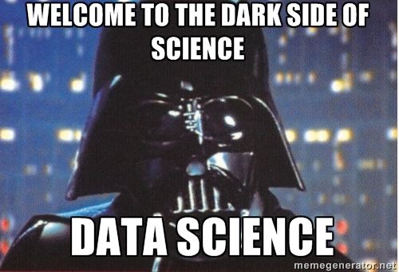
Agenda
What is Machine Learning?
Statistics vs Machine Learning
What is a good model?
Contextualizing ML Approaches
Defining an ML Problem
The Analytics Process
Model Development Workflow
Basic ML Concepts
Features vs Label / Target Variables
Domain Expertise
Feature Engineering
Train / Test Split
Baseline Model
Algorithms
Champion Model
Model Maintenance
Supervised Learning
Unsupervised Learning
Notes:
Pick what models are useful to have
Discuss other algorithms in the context of your capstone

Slide 7
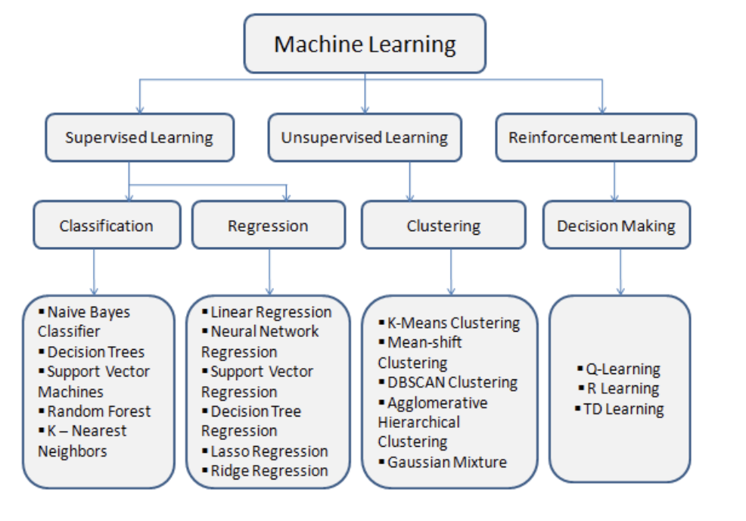
What is Machine Learning?
Machine learning is a method of data analysis that automates analytical model building.
Using algorithms that iteratively learn from data, machine learning allows computers to find hidden insights without being explicitly programmed where to look.
There are different types of machine learning we will focus on this week and next week:
Supervised Learning
Unsupervised Learning
Notes:
Pick what models are useful to have
Discuss other algorithms in the context of your capstone
https://www.analyticsvidhya.com/blog/2021/03/everything-you-need-to-know-about-machine-learning/

Slide 8
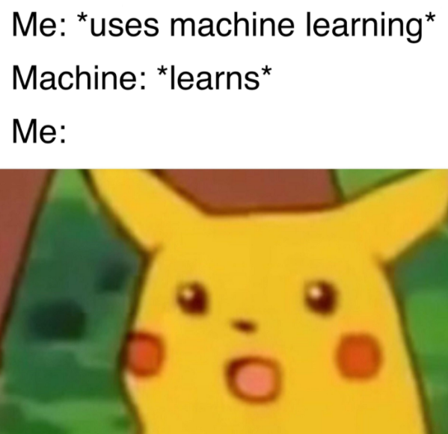
What is Machine Learning Used For?
Fraud detection.
Web search results.
Real-time ads on web pages
Credit scoring.
Prediction of equipment failures.
New pricing models.
Network intrusion detection.
Recommendation Engines
Customer Segmentation
Text Sentiment Analysis
Customer Churn
Pattern and image recognition.
Email spam filtering.
Notes:
Pick what models are useful to have
Discuss other algorithms in the context of your capstone

Slide 9
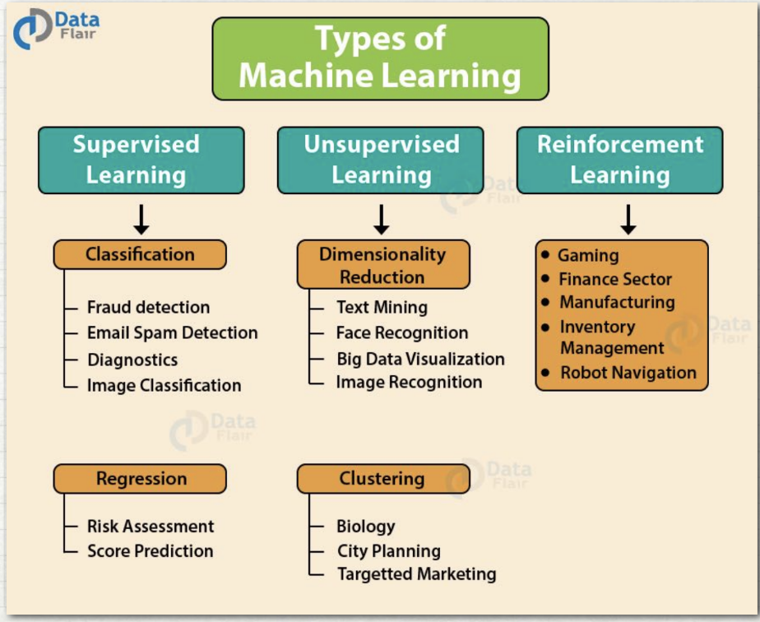
What is Machine Learning?
Supervised
Both inputs and outputs (X and Y)
We train the data on the relationship between the two, then test and make predictions
Example: annual promotion scores, top songs on Spotify
Two major types: regression and classification
Unsupervised
Only inputs and then finds structures based on the data, like clusters or categories based on similarities
Models learn relationships between data
Examples: Grouping customers by purchasing behavior, spam filters in email
Reinforcement
Inputs are given, and then the model is “rewarded” or “punished” based on output, evolves based on trial and error
Examples: AI playing games (AlphaGo Zero), robotics, self-driving cars, online stock trading
Notes:
Two paths to one common goal
Overall differences:
• Statistics: Mathematical formalization of relationships between variables, expressed in models that are then tested
• Machine learning: Using algorithms to learn from data without necessarily specifying the model at the outset
• Goals, broadly, on average are both to learn from data, but they diverge slightly:
• Statistics: Inference (Why is something happening? What is the relationship between variables of interest? What causes
economic growth?)
• ML: Prediction (What is going to happen next? Will people who do X also do Y? What will be the level of the stock market
one month from today?
• Origins:
• Statistics: Mathematics (hundreds of years!); mathematics of collections of observations!
• ML: Computer science and artificial intelligence (term invented in 1959 at IBM, resurgence in 1990s); deep idea that
computers can learn from data
• Some tradeoffs:
• Statistics: We have to think carefully about how the data was measured and collected, formulate a model of how the
variables are related, understand the statistical properties of outputs (p-values, coefficients, etc.), underlying distribution
of the population, LLN (ideas and inferences about what would happen if we did the same study many times). BUT: we do
get a bit more insight to understand relationships between variables
• Machine learning: Not necessary to have prior assumptions about the relationships between the variables, generally
need a lot of data for prediction. BUT: the output can be a black box — we don’t necessarily know why the prediction is
what it is, or better understand the relationship between underlying variables

Slide 10
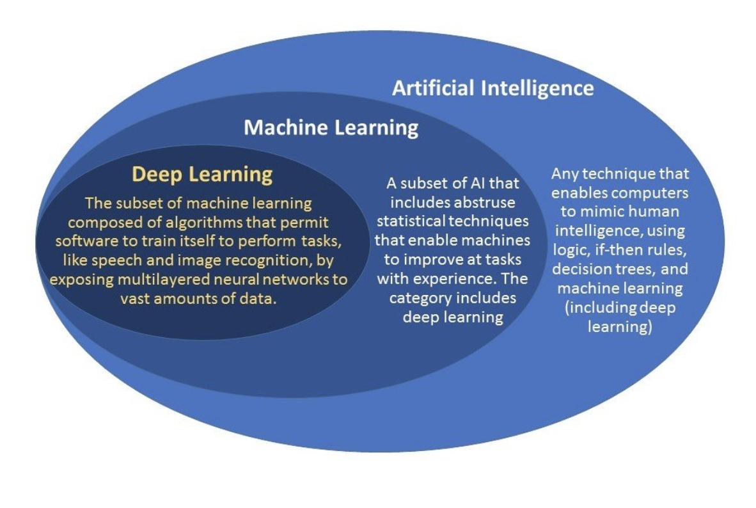
What is Machine Learning?
Notes:
https://medium.com/@harish_6956/what-is-machine-learning-deep-learning-7788604004da
AI - enables machines to think without human intervention
ML - subset of AI that uses statistical learning algos that learn pattern in data over time
DL - subset of ML that filters data through multiple layers

Slide 11
Statistical Modeling vs Machine Learning
Statistical Model
Machine Learning
A statistical model is a mathematical model that embodies a set of statistical assumptions concerning the generation of sample data (and similar data from a larger population). A statistical model represents, often in considerably idealized form, the data-generating process.
A statistical model is usually specified as a mathematical relationship between one or more random variables and other non-random variables
Statistical models are designed for inference about the relationships between variables. Many statistical models can make predictions, but predictive accuracy is not their strength.
Machine learning (ML) is the study of computer algorithms that improve automatically through experience. It is seen as a subset of artificial intelligence.
Machine learning algorithms build a mathematical model based on sample data, known as "training data", in order to make predictions or decisions without being explicitly programmed to do so.
Machine learning models are designed to make the most accurate predictions possible by learning from historical data. Machine learning models provide various degrees of interpretability but generally sacrifice interpretability for predictive power.
Notes:
Two paths to one common goal
Overall differences:
• Statistics: Mathematical formalization of relationships between variables, expressed in models that are then tested
• Machine learning: Using algorithms to learn from data without necessarily specifying the model at the outset
• Goals, broadly, on average are both to learn from data, but they diverge slightly:
• Statistics: Inference (Why is something happening? What is the relationship between variables of interest? What causes
economic growth?)
• ML: Prediction (What is going to happen next? Will people who do X also do Y? What will be the level of the stock market
one month from today?

Slide 12
Statistical Modeling vs Machine Learning
Statistical Model
Machine Learning
Mathematical formalization of relationships between variables, expressed in models that are then tested
Goal: Inference (Why is something happening? What is the relationship between variables of interest? What causes economic growth?)
Statisticians can help think about underlying data, possibilities for causal inference
Using algorithms to learn from data without necessarily specifying the model at the outset
Goal: Prediction (What is going to happen next? Will people who do X also do Y? What will be the level of the stock market one month from today?)
ML experts can help build algorithms to make predictions that we hope are good
Notes:
Two paths to one common goal - data science as the bridge between these two worlds
Overall differences:
• Statistics: Mathematical formalization of relationships between variables, expressed in models that are then tested
• Machine learning: Using algorithms to learn from data without necessarily specifying the model at the outset
• Goals, broadly, on average are both to learn from data, but they diverge slightly:
• Statistics: Inference (Why is something happening? What is the relationship between variables of interest? What causes
economic growth?)
• ML: Prediction (What is going to happen next? Will people who do X also do Y? What will be the level of the stock market
one month from today?
• Origins:
• Statistics: Mathematics (hundreds of years!); mathematics of collections of observations!
• ML: Computer science and artificial intelligence (term invented in 1959 at IBM, resurgence in 1990s); deep idea that
computers can learn from data
• Some tradeoffs:
• Statistics: We have to think carefully about how the data was measured and collected, formulate a model of how the
variables are related, understand the statistical properties of outputs (p-values, coefficients, etc.), underlying distribution
of the population, LLN (ideas and inferences about what would happen if we did the same study many times). BUT: we do
get a bit more insight to understand relationships between variables
• Machine learning: Not necessary to have prior assumptions about the relationships between the variables, generally
need a lot of data for prediction. BUT: the output can be a black box — we don’t necessarily know why the prediction is
what it is, or better understand the relationship between underlying variables

Slide 13
What defines a good model?
Model Fit
Goodness of Fit - whether model adequately describes the relations in the current data
Prediction Accuracy - whether model adequately predicts new data
Parsimony
A parsimonious model is a model that accomplishes a desired level of explanation or prediction with as few predictor variables as possible
Usability
Data Requirements
Technology Requirements
Training and Scoring Performance
Note that we will discuss this in more detail in the “Supervised Learning” section
Notes:
Two paths to one common goal
Overall differences:
• Statistics: Mathematical formalization of relationships between variables, expressed in models that are then tested
• Machine learning: Using algorithms to learn from data without necessarily specifying the model at the outset
• Goals, broadly, on average are both to learn from data, but they diverge slightly:
• Statistics: Inference (Why is something happening? What is the relationship between variables of interest? What causes
economic growth?)
• ML: Prediction (What is going to happen next? Will people who do X also do Y? What will be the level of the stock market
one month from today?
• Origins:
• Statistics: Mathematics (hundreds of years!); mathematics of collections of observations!
• ML: Computer science and artificial intelligence (term invented in 1959 at IBM, resurgence in 1990s); deep idea that
computers can learn from data
• Some tradeoffs:
• Statistics: We have to think carefully about how the data was measured and collected, formulate a model of how the
variables are related, understand the statistical properties of outputs (p-values, coefficients, etc.), underlying distribution
of the population, LLN (ideas and inferences about what would happen if we did the same study many times). BUT: we do
get a bit more insight to understand relationships between variables
• Machine learning: Not necessary to have prior assumptions about the relationships between the variables, generally
need a lot of data for prediction. BUT: the output can be a black box — we don’t necessarily know why the prediction is
what it is, or better understand the relationship between underlying variables

Slide 14
Agenda
What is Machine Learning?
Statistics vs Machine Learning
What is a good model?
Contextualizing ML Approaches
Defining an ML Problem
The Analytics Process
Model Development Workflow
Basic ML Concepts
Features vs Label / Target Variables
Domain Expertise
Feature Engineering
Train / Test Split
Baseline Model
Algorithms
Champion Model
Model Maintenance
Supervised Learning
Unsupervised Learning
Notes:
Pick what models are useful to have
Discuss other algorithms in the context of your capstone

Slide 15
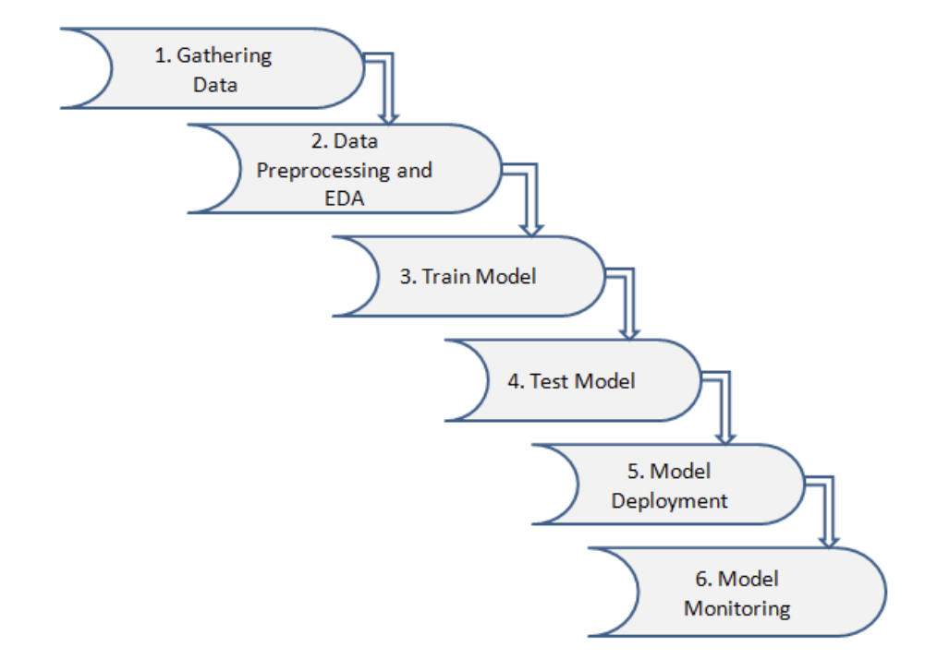
Contextualizing ML Approaches: The Machine Learning Life Cycle
Notes:
Two paths to one common goal
Overall differences:
• Statistics: Mathematical formalization of relationships between variables, expressed in models that are then tested
• Machine learning: Using algorithms to learn from data without necessarily specifying the model at the outset
• Goals, broadly, on average are both to learn from data, but they diverge slightly:
• Statistics: Inference (Why is something happening? What is the relationship between variables of interest? What causes
economic growth?)
• ML: Prediction (What is going to happen next? Will people who do X also do Y? What will be the level of the stock market
one month from today?
• Origins:
• Statistics: Mathematics (hundreds of years!); mathematics of collections of observations!
• ML: Computer science and artificial intelligence (term invented in 1959 at IBM, resurgence in 1990s); deep idea that
computers can learn from data
• Some tradeoffs:
• Statistics: We have to think carefully about how the data was measured and collected, formulate a model of how the
variables are related, understand the statistical properties of outputs (p-values, coefficients, etc.), underlying distribution
of the population, LLN (ideas and inferences about what would happen if we did the same study many times). BUT: we do
get a bit more insight to understand relationships between variables
• Machine learning: Not necessary to have prior assumptions about the relationships between the variables, generally
need a lot of data for prediction. BUT: the output can be a black box — we don’t necessarily know why the prediction is
what it is, or better understand the relationship between underlying variables

Slide 16
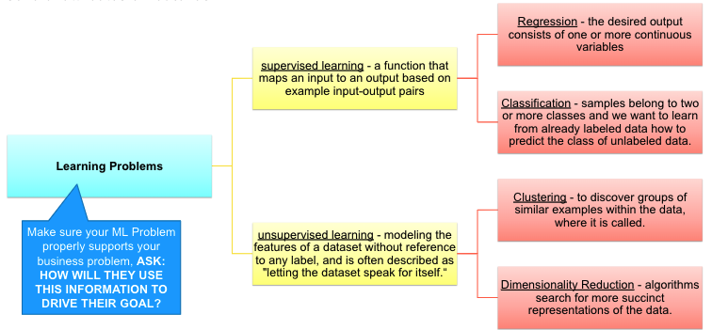
Contextualizing ML Approaches: Defining an ML Problem
In general, a learning problem considers a set of n samples of data and then tries to predict properties of unknown data. If each sample is more than a single number and, for instance, a multi-dimensional entry (aka multivariate data), it is said to have several attributes or features.

Slide 17
The Analytics Process
Deployment simply means getting the analytics model used as to how it’s intended to address the business problem, so that it involves interacting with the business users who will use the model or results of the model. That said, there are different methods to deploy the models, but the following tasks need to be performed regardless of the method chosen by the user:
Perform business validation of the model
Deliver report with findings; or
Create model, usability, and system requirements for production
Deliver production model/system
Support deployment
Business Problem Framing
Analytics Problem Framing
Data Requirements
Methodology Selection
Model building
Deployment
Model Lifecycle Management

Slide 18
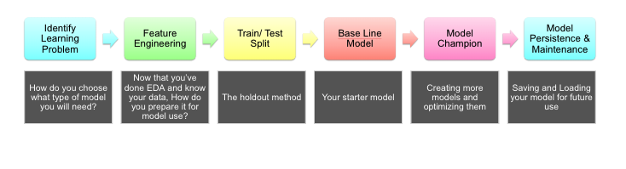
Contextualizing ML Approaches: Model Development Workflow

Slide 19
Agenda
What is Machine Learning?
Statistics vs Machine Learning
What is a good model?
Contextualizing ML Approaches
Defining an ML Problem
The Analytics Process
Model Development Workflow
Basic ML Concepts
Features vs Label / Target Variables
Domain Expertise
Feature Engineering
Train / Test Split
Baseline Model
Algorithms
Champion Model
Model Maintenance
Supervised Learning
Unsupervised Learning
Notes:
Pick what models are useful to have
Discuss other algorithms in the context of your capstone
Honestly mostly data cleaning
https://www.researchgate.net/publication/359994795_Developing_a_Titanic_Survival_Scorecard_Risk_Analysis_of_Populations_Through_Statistical_Scoring_Methods
https://www.researchgate.net/publication/358356552_Philippines_Data_Analytics_Sector_Labor_Market_Intelligence_Report
https://www.researchgate.net/publication/354046725_Trends_in_COVID-19_Vaccine_Acceptance_in_the_Philippines_and_their_Implications_on_Health_Communication

Slide 20
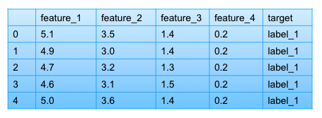
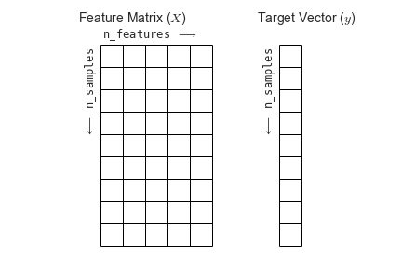
Basic ML Concepts: Features vs Label / Target Variable
A basic table is a two-dimensional grid of data, in which the rows represent individual elements of the dataset, and the columns represent quantities related to each of these elements. Normally, you will find your data in this format.
To prepare for Machine Learning, you would need to be able to identify and separate your features and targets.
features: independent, X,
target: dependent, y, label, prediction, score
[n_samples, n_features] [n_targets]
Notes:
Two paths to one common goal
Overall differences:
• Statistics: Mathematical formalization of relationships between variables, expressed in models that are then tested
• Machine learning: Using algorithms to learn from data without necessarily specifying the model at the outset
• Goals, broadly, on average are both to learn from data, but they diverge slightly:
• Statistics: Inference (Why is something happening? What is the relationship between variables of interest? What causes
economic growth?)
• ML: Prediction (What is going to happen next? Will people who do X also do Y? What will be the level of the stock market
one month from today?
• Origins:
• Statistics: Mathematics (hundreds of years!); mathematics of collections of observations!
• ML: Computer science and artificial intelligence (term invented in 1959 at IBM, resurgence in 1990s); deep idea that
computers can learn from data
• Some tradeoffs:
• Statistics: We have to think carefully about how the data was measured and collected, formulate a model of how the
variables are related, understand the statistical properties of outputs (p-values, coefficients, etc.), underlying distribution
of the population, LLN (ideas and inferences about what would happen if we did the same study many times). BUT: we do
get a bit more insight to understand relationships between variables
• Machine learning: Not necessary to have prior assumptions about the relationships between the variables, generally
need a lot of data for prediction. BUT: the output can be a black box — we don’t necessarily know why the prediction is
what it is, or better understand the relationship between underlying variables

Slide 21
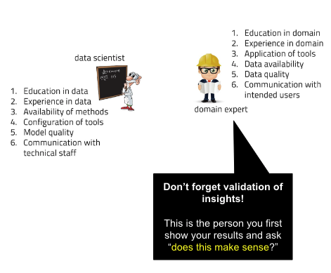
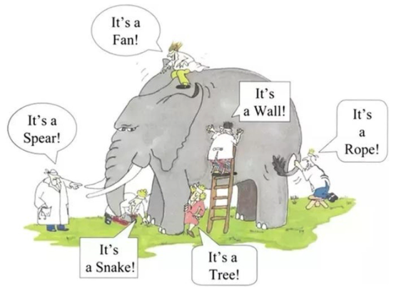
Basic ML Concepts: Domain Expertise
Notes:
Two paths to one common goal
Overall differences:
• Statistics: Mathematical formalization of relationships between variables, expressed in models that are then tested
• Machine learning: Using algorithms to learn from data without necessarily specifying the model at the outset
• Goals, broadly, on average are both to learn from data, but they diverge slightly:
• Statistics: Inference (Why is something happening? What is the relationship between variables of interest? What causes
economic growth?)
• ML: Prediction (What is going to happen next? Will people who do X also do Y? What will be the level of the stock market
one month from today?
• Origins:
• Statistics: Mathematics (hundreds of years!); mathematics of collections of observations!
• ML: Computer science and artificial intelligence (term invented in 1959 at IBM, resurgence in 1990s); deep idea that
computers can learn from data
• Some tradeoffs:
• Statistics: We have to think carefully about how the data was measured and collected, formulate a model of how the
variables are related, understand the statistical properties of outputs (p-values, coefficients, etc.), underlying distribution
of the population, LLN (ideas and inferences about what would happen if we did the same study many times). BUT: we do
get a bit more insight to understand relationships between variables
• Machine learning: Not necessary to have prior assumptions about the relationships between the variables, generally
need a lot of data for prediction. BUT: the output can be a black box — we don’t necessarily know why the prediction is
what it is, or better understand the relationship between underlying variables

Slide 22
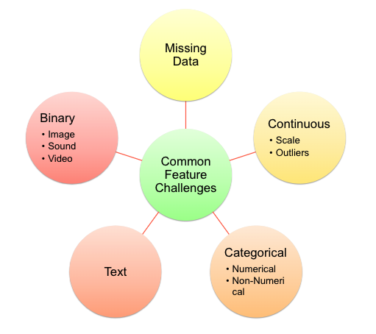
Basic ML Concepts: Feature Engineering
Models best function by having pre-prepared set of format / structure for its input and expected output.
Given this, Data scientists need to be able to review the dataset and “massage” them to conform to the format that would best work with the model.
Additionally, Model metrics can further be improved by the addition (or removal) of features that either add further variance or noise to the model.
Notes:
Two paths to one common goal
Overall differences:
• Statistics: Mathematical formalization of relationships between variables, expressed in models that are then tested
• Machine learning: Using algorithms to learn from data without necessarily specifying the model at the outset
• Goals, broadly, on average are both to learn from data, but they diverge slightly:
• Statistics: Inference (Why is something happening? What is the relationship between variables of interest? What causes
economic growth?)
• ML: Prediction (What is going to happen next? Will people who do X also do Y? What will be the level of the stock market
one month from today?
• Origins:
• Statistics: Mathematics (hundreds of years!); mathematics of collections of observations!
• ML: Computer science and artificial intelligence (term invented in 1959 at IBM, resurgence in 1990s); deep idea that
computers can learn from data
• Some tradeoffs:
• Statistics: We have to think carefully about how the data was measured and collected, formulate a model of how the
variables are related, understand the statistical properties of outputs (p-values, coefficients, etc.), underlying distribution
of the population, LLN (ideas and inferences about what would happen if we did the same study many times). BUT: we do
get a bit more insight to understand relationships between variables
• Machine learning: Not necessary to have prior assumptions about the relationships between the variables, generally
need a lot of data for prediction. BUT: the output can be a black box — we don’t necessarily know why the prediction is
what it is, or better understand the relationship between underlying variables

Slide 23
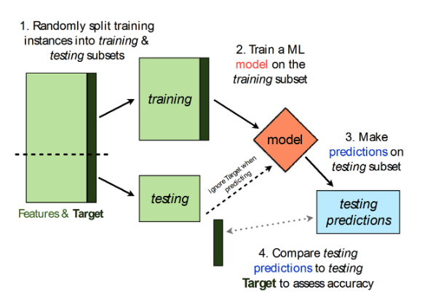
Basic ML Concepts: Train / Test Split
A key goal we have for model development is to arrive at a performant model that would generalize to be able to handle new unknown data and be able to predict with as minimal bias as possible.
How do we prevent overfitting?
common question we will try to answer throughout the modeling process
Is there a way for us to estimate the degree of underfit / overfit?
the hold out method is a basic statistical technique
There are more sophisticated techniques to manage under/overfitting
In other news, are there other considerations should we take into account when building models that might ‘invalidate’ its usability?
Notes:
Two paths to one common goal
Overall differences:
• Statistics: Mathematical formalization of relationships between variables, expressed in models that are then tested
• Machine learning: Using algorithms to learn from data without necessarily specifying the model at the outset
• Goals, broadly, on average are both to learn from data, but they diverge slightly:
• Statistics: Inference (Why is something happening? What is the relationship between variables of interest? What causes
economic growth?)
• ML: Prediction (What is going to happen next? Will people who do X also do Y? What will be the level of the stock market
one month from today?
• Origins:
• Statistics: Mathematics (hundreds of years!); mathematics of collections of observations!
• ML: Computer science and artificial intelligence (term invented in 1959 at IBM, resurgence in 1990s); deep idea that
computers can learn from data
• Some tradeoffs:
• Statistics: We have to think carefully about how the data was measured and collected, formulate a model of how the
variables are related, understand the statistical properties of outputs (p-values, coefficients, etc.), underlying distribution
of the population, LLN (ideas and inferences about what would happen if we did the same study many times). BUT: we do
get a bit more insight to understand relationships between variables
• Machine learning: Not necessary to have prior assumptions about the relationships between the variables, generally
need a lot of data for prediction. BUT: the output can be a black box — we don’t necessarily know why the prediction is
what it is, or better understand the relationship between underlying variables

Slide 24
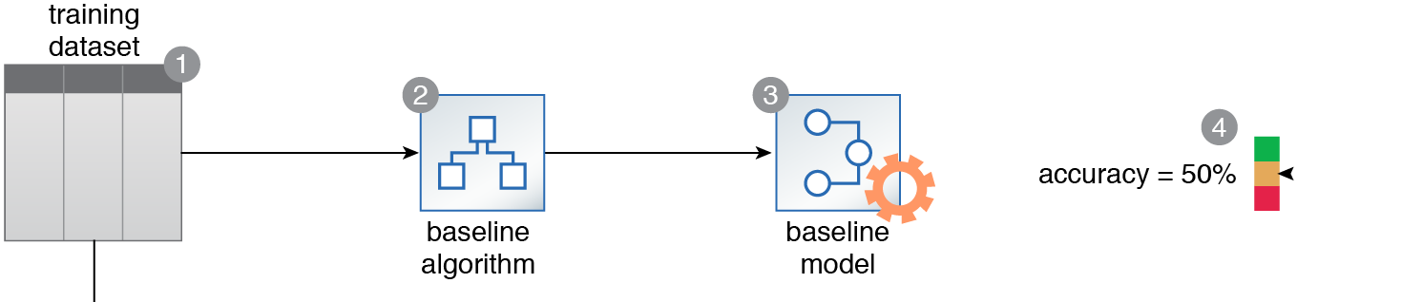
Basic ML Concepts: Baseline Model
How can it be assured that a trained model is a performant model that adds value?
A baseline is established via a simple algorithm that serves as a yardstick for measuring the effectiveness of other complex models.
There may be more than one type of algorithm that can be applied to solve a particular type of machine learning problem.
However, without knowing how much extra value, if at all, one model carries over others, a sub-optimal model may be selected with the further possibility of experiencing lost time and processing resources.
Accuracy is one metric that can be measured to evaluate models. Depending on the type of model there are more that can help us better understand its performance ie. Confusion matrix for classifiers
Notes:
Two paths to one common goal
Overall differences:
• Statistics: Mathematical formalization of relationships between variables, expressed in models that are then tested
• Machine learning: Using algorithms to learn from data without necessarily specifying the model at the outset
• Goals, broadly, on average are both to learn from data, but they diverge slightly:
• Statistics: Inference (Why is something happening? What is the relationship between variables of interest? What causes
economic growth?)
• ML: Prediction (What is going to happen next? Will people who do X also do Y? What will be the level of the stock market
one month from today?
• Origins:
• Statistics: Mathematics (hundreds of years!); mathematics of collections of observations!
• ML: Computer science and artificial intelligence (term invented in 1959 at IBM, resurgence in 1990s); deep idea that
computers can learn from data
• Some tradeoffs:
• Statistics: We have to think carefully about how the data was measured and collected, formulate a model of how the
variables are related, understand the statistical properties of outputs (p-values, coefficients, etc.), underlying distribution
of the population, LLN (ideas and inferences about what would happen if we did the same study many times). BUT: we do
get a bit more insight to understand relationships between variables
• Machine learning: Not necessary to have prior assumptions about the relationships between the variables, generally
need a lot of data for prediction. BUT: the output can be a black box — we don’t necessarily know why the prediction is
what it is, or better understand the relationship between underlying variables

Slide 25

Basic ML Concepts: Algorithms
Some things to think about when choosing your estimator:
Interpretability
Accuracy
Flexibility
Speed
Scalability
Notes:
Two paths to one common goal
Overall differences:
• Statistics: Mathematical formalization of relationships between variables, expressed in models that are then tested
• Machine learning: Using algorithms to learn from data without necessarily specifying the model at the outset
• Goals, broadly, on average are both to learn from data, but they diverge slightly:
• Statistics: Inference (Why is something happening? What is the relationship between variables of interest? What causes
economic growth?)
• ML: Prediction (What is going to happen next? Will people who do X also do Y? What will be the level of the stock market
one month from today?
• Origins:
• Statistics: Mathematics (hundreds of years!); mathematics of collections of observations!
• ML: Computer science and artificial intelligence (term invented in 1959 at IBM, resurgence in 1990s); deep idea that
computers can learn from data
• Some tradeoffs:
• Statistics: We have to think carefully about how the data was measured and collected, formulate a model of how the
variables are related, understand the statistical properties of outputs (p-values, coefficients, etc.), underlying distribution
of the population, LLN (ideas and inferences about what would happen if we did the same study many times). BUT: we do
get a bit more insight to understand relationships between variables
• Machine learning: Not necessary to have prior assumptions about the relationships between the variables, generally
need a lot of data for prediction. BUT: the output can be a black box — we don’t necessarily know why the prediction is
what it is, or better understand the relationship between underlying variables

Slide 26
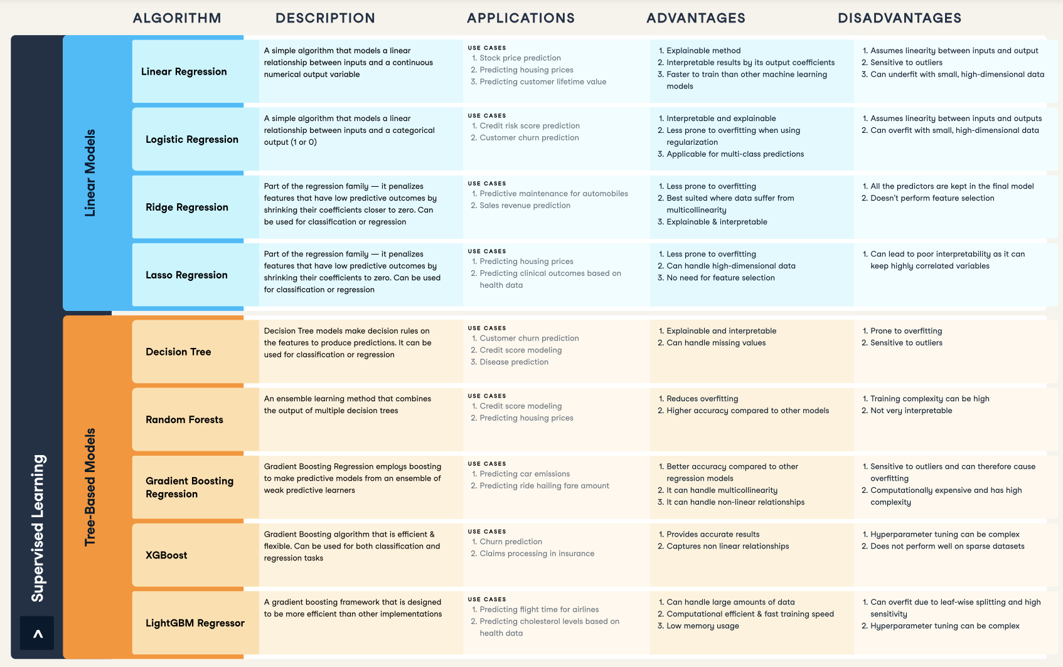
Basic ML Concepts: Algorithms
Some things to think about when choosing your estimator:
Interpretability
Accuracy
Flexibility
Speed
Scalability
Notes:
Two paths to one common goal
Overall differences:
• Statistics: Mathematical formalization of relationships between variables, expressed in models that are then tested
• Machine learning: Using algorithms to learn from data without necessarily specifying the model at the outset
• Goals, broadly, on average are both to learn from data, but they diverge slightly:
• Statistics: Inference (Why is something happening? What is the relationship between variables of interest? What causes
economic growth?)
• ML: Prediction (What is going to happen next? Will people who do X also do Y? What will be the level of the stock market
one month from today?
• Origins:
• Statistics: Mathematics (hundreds of years!); mathematics of collections of observations!
• ML: Computer science and artificial intelligence (term invented in 1959 at IBM, resurgence in 1990s); deep idea that
computers can learn from data
• Some tradeoffs:
• Statistics: We have to think carefully about how the data was measured and collected, formulate a model of how the
variables are related, understand the statistical properties of outputs (p-values, coefficients, etc.), underlying distribution
of the population, LLN (ideas and inferences about what would happen if we did the same study many times). BUT: we do
get a bit more insight to understand relationships between variables
• Machine learning: Not necessary to have prior assumptions about the relationships between the variables, generally
need a lot of data for prediction. BUT: the output can be a black box — we don’t necessarily know why the prediction is
what it is, or better understand the relationship between underlying variables

Slide 27
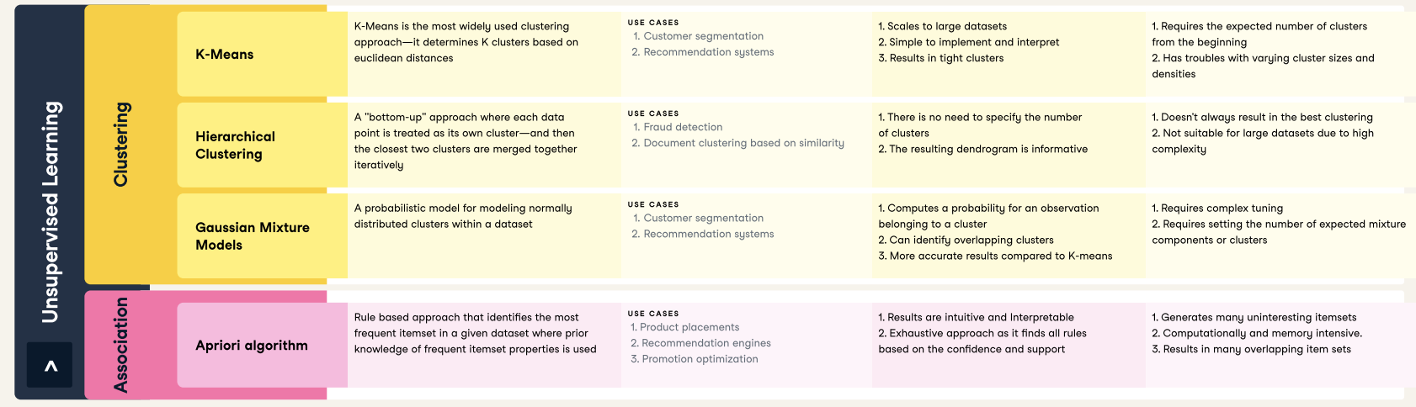
Basic ML Concepts: Algorithms
Some things to think about when choosing your estimator:
Interpretability
Accuracy
Flexibility
Speed
Scalability
Notes:
Two paths to one common goal
Overall differences:
• Statistics: Mathematical formalization of relationships between variables, expressed in models that are then tested
• Machine learning: Using algorithms to learn from data without necessarily specifying the model at the outset
• Goals, broadly, on average are both to learn from data, but they diverge slightly:
• Statistics: Inference (Why is something happening? What is the relationship between variables of interest? What causes
economic growth?)
• ML: Prediction (What is going to happen next? Will people who do X also do Y? What will be the level of the stock market
one month from today?
• Origins:
• Statistics: Mathematics (hundreds of years!); mathematics of collections of observations!
• ML: Computer science and artificial intelligence (term invented in 1959 at IBM, resurgence in 1990s); deep idea that
computers can learn from data
• Some tradeoffs:
• Statistics: We have to think carefully about how the data was measured and collected, formulate a model of how the
variables are related, understand the statistical properties of outputs (p-values, coefficients, etc.), underlying distribution
of the population, LLN (ideas and inferences about what would happen if we did the same study many times). BUT: we do
get a bit more insight to understand relationships between variables
• Machine learning: Not necessary to have prior assumptions about the relationships between the variables, generally
need a lot of data for prediction. BUT: the output can be a black box — we don’t necessarily know why the prediction is
what it is, or better understand the relationship between underlying variables

Slide 28
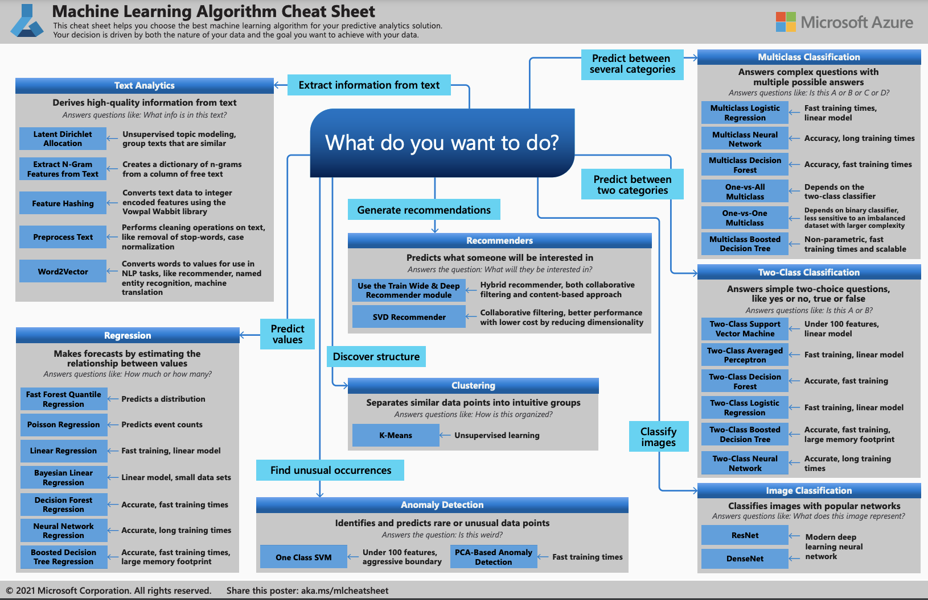
Basic ML Concepts: Algorithms
Notes:
Two paths to one common goal
Overall differences:
• Statistics: Mathematical formalization of relationships between variables, expressed in models that are then tested
• Machine learning: Using algorithms to learn from data without necessarily specifying the model at the outset
• Goals, broadly, on average are both to learn from data, but they diverge slightly:
• Statistics: Inference (Why is something happening? What is the relationship between variables of interest? What causes
economic growth?)
• ML: Prediction (What is going to happen next? Will people who do X also do Y? What will be the level of the stock market
one month from today?
• Origins:
• Statistics: Mathematics (hundreds of years!); mathematics of collections of observations!
• ML: Computer science and artificial intelligence (term invented in 1959 at IBM, resurgence in 1990s); deep idea that
computers can learn from data
• Some tradeoffs:
• Statistics: We have to think carefully about how the data was measured and collected, formulate a model of how the
variables are related, understand the statistical properties of outputs (p-values, coefficients, etc.), underlying distribution
of the population, LLN (ideas and inferences about what would happen if we did the same study many times). BUT: we do
get a bit more insight to understand relationships between variables
• Machine learning: Not necessary to have prior assumptions about the relationships between the variables, generally
need a lot of data for prediction. BUT: the output can be a black box — we don’t necessarily know why the prediction is
what it is, or better understand the relationship between underlying variables

Slide 29
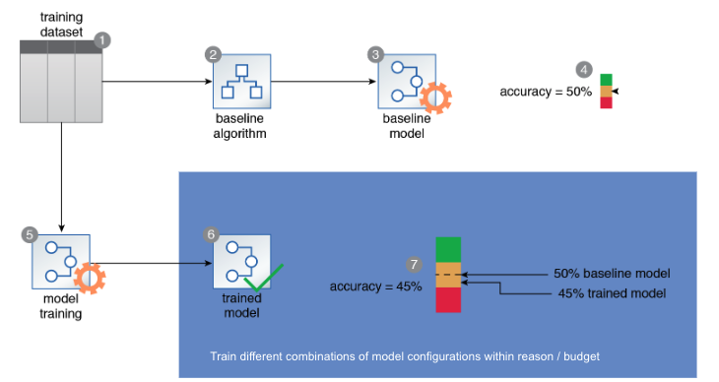
Basic ML Concepts: Choosing the Champion Model
Model development requires an iterative process where we create many different instances of a particular model and/or use different types of models that we will each evaluate to eventually arrive at our best performant version aka our champion model.
The following items can be considered when developing your model iterations:
Identification of metrics to track
Changes to Hyperparameter configuration
Algorithms to try
Feature engineering
Notes:
Two paths to one common goal
Overall differences:
• Statistics: Mathematical formalization of relationships between variables, expressed in models that are then tested
• Machine learning: Using algorithms to learn from data without necessarily specifying the model at the outset
• Goals, broadly, on average are both to learn from data, but they diverge slightly:
• Statistics: Inference (Why is something happening? What is the relationship between variables of interest? What causes
economic growth?)
• ML: Prediction (What is going to happen next? Will people who do X also do Y? What will be the level of the stock market
one month from today?
• Origins:
• Statistics: Mathematics (hundreds of years!); mathematics of collections of observations!
• ML: Computer science and artificial intelligence (term invented in 1959 at IBM, resurgence in 1990s); deep idea that
computers can learn from data
• Some tradeoffs:
• Statistics: We have to think carefully about how the data was measured and collected, formulate a model of how the
variables are related, understand the statistical properties of outputs (p-values, coefficients, etc.), underlying distribution
of the population, LLN (ideas and inferences about what would happen if we did the same study many times). BUT: we do
get a bit more insight to understand relationships between variables
• Machine learning: Not necessary to have prior assumptions about the relationships between the variables, generally
need a lot of data for prediction. BUT: the output can be a black box — we don’t necessarily know why the prediction is
what it is, or better understand the relationship between underlying variables

Slide 30
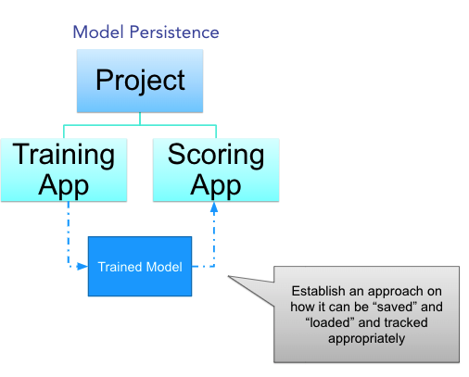
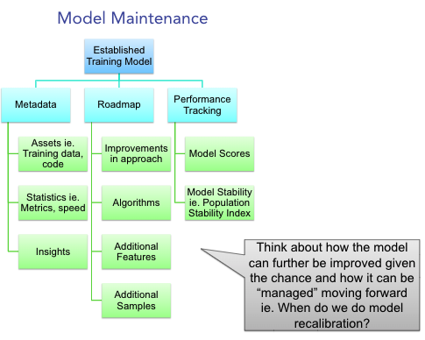
Basic ML Concepts: Model Maintenance
What do you do after developing your model?
Notes:
Two paths to one common goal
Overall differences:
• Statistics: Mathematical formalization of relationships between variables, expressed in models that are then tested
• Machine learning: Using algorithms to learn from data without necessarily specifying the model at the outset
• Goals, broadly, on average are both to learn from data, but they diverge slightly:
• Statistics: Inference (Why is something happening? What is the relationship between variables of interest? What causes
economic growth?)
• ML: Prediction (What is going to happen next? Will people who do X also do Y? What will be the level of the stock market
one month from today?
• Origins:
• Statistics: Mathematics (hundreds of years!); mathematics of collections of observations!
• ML: Computer science and artificial intelligence (term invented in 1959 at IBM, resurgence in 1990s); deep idea that
computers can learn from data
• Some tradeoffs:
• Statistics: We have to think carefully about how the data was measured and collected, formulate a model of how the
variables are related, understand the statistical properties of outputs (p-values, coefficients, etc.), underlying distribution
of the population, LLN (ideas and inferences about what would happen if we did the same study many times). BUT: we do
get a bit more insight to understand relationships between variables
• Machine learning: Not necessary to have prior assumptions about the relationships between the variables, generally
need a lot of data for prediction. BUT: the output can be a black box — we don’t necessarily know why the prediction is
what it is, or better understand the relationship between underlying variables

Slide 31
Supervised Learning
Week 9

Slide 32
Supervised Learning
Supervised learning algorithms are trained using labeled examples, such as an input where the desired output is known.
For example, a segment of text could have a category label, such as:
Spam vs. Legitimate Email
Positive vs. Negative Movie Review
Supervised learning is commonly used in applications where historical data predicts likely future events
The model receives a set of inputs along with the corresponding correct outputs, and the algorithm learns by comparing its actual output with correct outputs to find errors.
It then modifies the model accordingly.

Slide 33
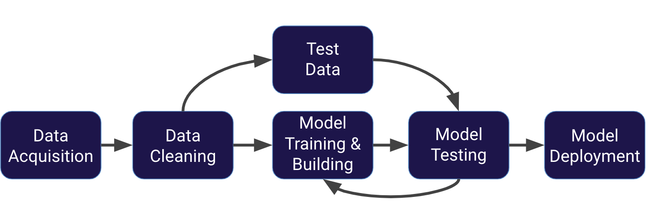
Supervised Learning: A Review of the ML Process
To fix this issue, data is often split into 3 sets
Training Data: Used to train model parameters
Validation Data: Used to determine what model hyperparameters to adjust
Test Data: Used to get some final performance metric
This means after we see the results on the final test set we don’t get to go back and adjust any model parameters!
This final measure is what we label the true performance of the model to be.
Notes:
https://docs.google.com/presentation/d/1WurfW8OWRqjiSmzmwOW71iN6CEShkbfOnyETqTvf6BE/edit#slide=id.g5c6d0d8677_0_239
What we just showed is a simplified approach to supervised learning, it contains an issue!
Is it fair to use our single split of the data to evaluate our models performance?
After all, we were given the chance to update the model parameters again and again.
In this course, in general we will simplify our data by using a simple train/test split.
We will simply train and then evaluate on a test set (leaving the option to students to go back and adjust parameters).
After going through the course, you will be able to easily perform another split to get 3 data sets if you desire.

Slide 34
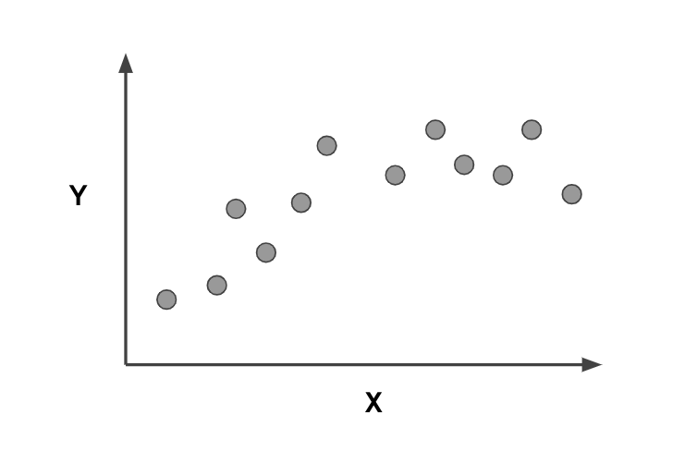
Supervised Learning: Overfitting & Undefitting
Overfitting
The model fits too much to the noise from the data.
This often results in low error on training sets but high error on test/validation sets.
What would a good model look like?
Notes:
Now that we understand the full process for supervised learning, let’s touch upon the important topics of overfitting and underfitting.
If you were to draw a line, that describes the trend, what would a good model look like?

Slide 35
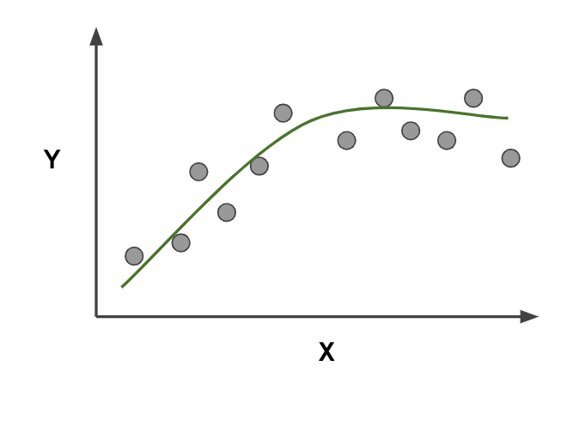
Supervised Learning: Overfitting & Undefitting
Overfitting
The model fits too much to the noise from the data.
This often results in low error on training sets but high error on test/validation sets.
Good Model
Notes:
Now that we understand the full process for supervised learning, let’s touch upon the important topics of overfitting and underfitting.
If you were to draw a line, that describes the trend, what would a good model look like?

Slide 36
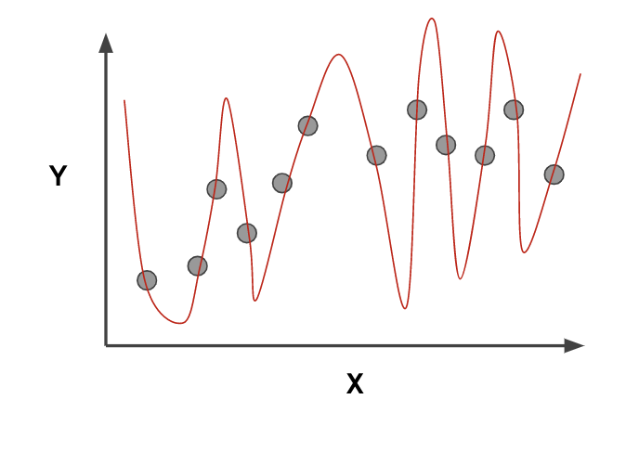
Supervised Learning: Overfitting & Undefitting
Overfitting
The model fits too much to the noise from the data.
This often results in low error on training sets but high error on test/validation sets.
Overfitting
Notes:
Now that we understand the full process for supervised learning, let’s touch upon the important topics of overfitting and underfitting.
If you were to draw a line, that describes the trend, what would a good model look like?

Slide 37
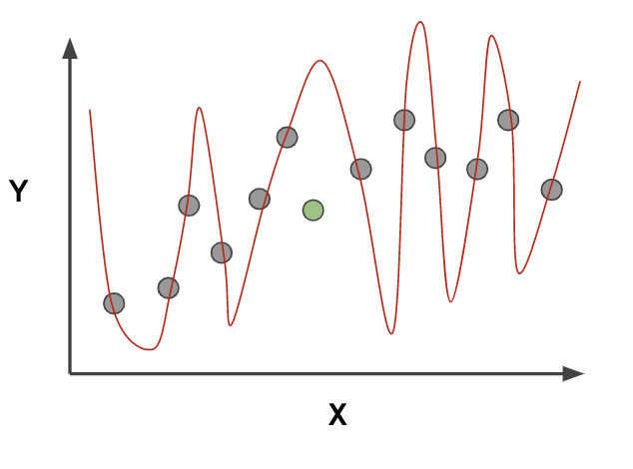
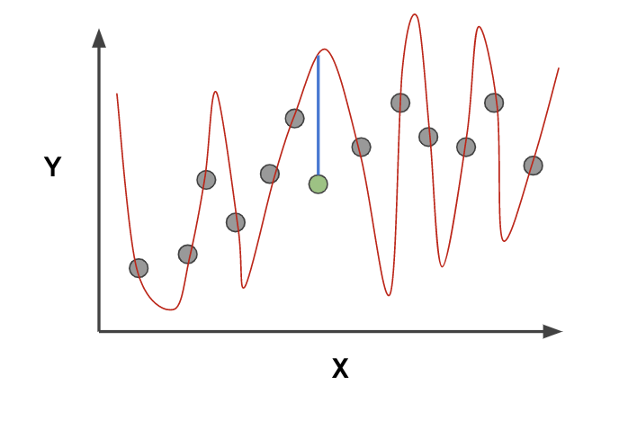
Supervised Learning: Overfitting & Undefitting
Overfitting
The model fits too much to the noise from the data.
This often results in low error on training sets but high error on test/validation sets.
Notes:
Now that we understand the full process for supervised learning, let’s touch upon the important topics of overfitting and underfitting.
If you were to draw a line, that describes the trend, what would a good model look like?

Slide 38
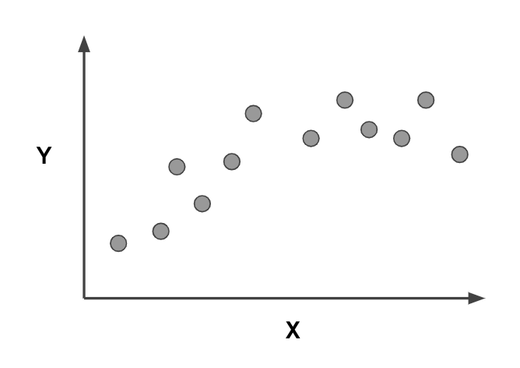
Supervised Learning: Overfitting & Undefitting
Underfitting
Model does not capture the underlying trend of the data and does not fit the data well enough.
Low variance but high bias.
Underfitting is often a result of an excessively simple model.
How would underfitting look?
Notes:
Now that we understand the full process for supervised learning, let’s touch upon the important topics of overfitting and underfitting.
If you were to draw a line, that describes the trend, what would a good model look like?

Slide 39
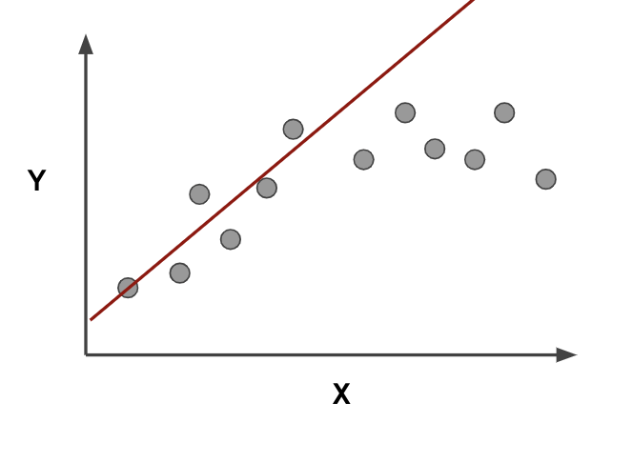
Supervised Learning: Overfitting & Undefitting
Underfitting
Model does not capture the underlying trend of the data and does not fit the data well enough.
Low variance but high bias.
Underfitting is often a result of an excessively simple model.
How would underfitting look?
Notes:
This data was easy to visualize, but how can we see underfitting and overfitting when dealing with multi dimensional data sets?
First let’s imagine we trained a model and then measured its error over training time.

Slide 40
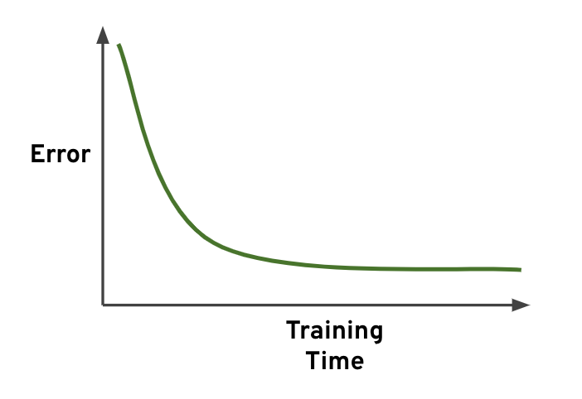
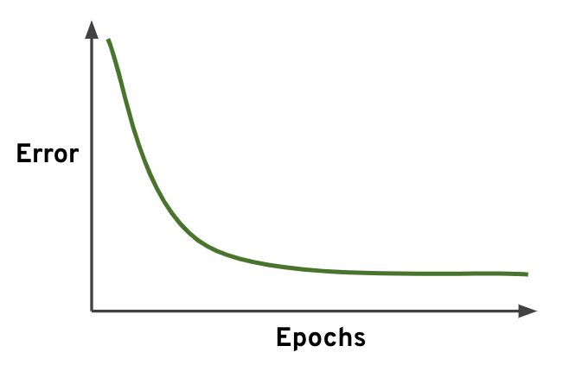
Supervised Learning: Overfitting & Undefitting for Multidimensional Data
“Good model”
Notes:
This data was easy to visualize, but how can we see underfitting and overfitting when dealing with multi dimensional data sets?
First let’s imagine we trained a model and then measured its error over training time.

Slide 41
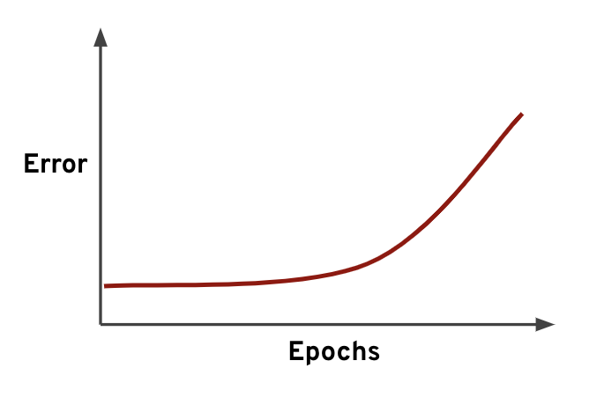
Supervised Learning: Overfitting & Undefitting for Multidimensional Data
“Good model”
“Bad model”
Notes:
When thinking about overfitting and underfitting we want to keep in mind the relationship of model performance on the training set versus the test/validation set.

Slide 42
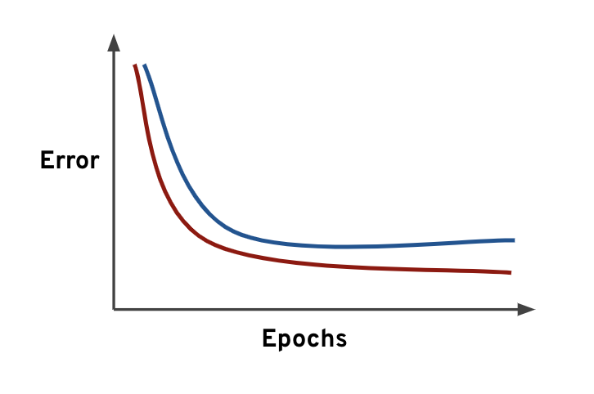
Supervised Learning: Overfitting & Undefitting for Multidimensional Data
When thinking about overfitting and underfitting we want to keep in mind the relationship of model performance on the training set versus the test/validation set.
Blue = Test Set
Red = Train Set
Ideally the model would perform well on both, with similar behavior.
“Good model”
Notes:
When thinking about overfitting and underfitting we want to keep in mind the relationship of model performance on the training set versus the test/validation set.
Let’s imagine we split our data into a training set and a test set
We first see performance on the training set
Next we check performance on the test set

Slide 43

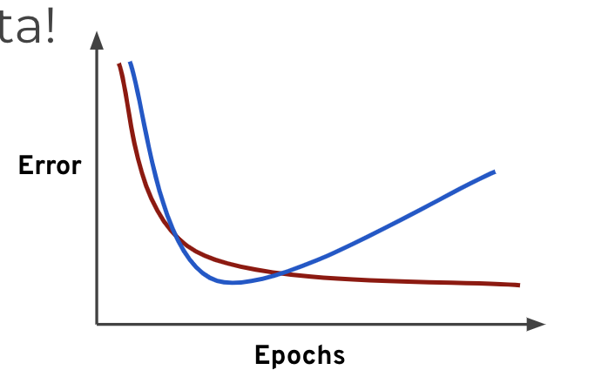
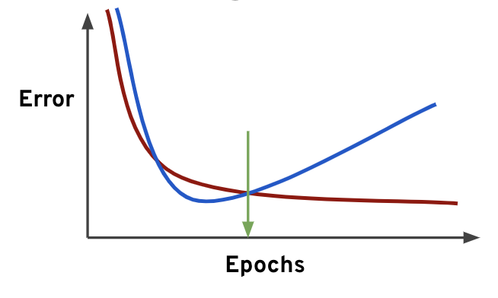
Supervised Learning: Overfitting & Undefitting for Multidimensional Data
But what happens if we overfit on the training data? That means we would perform poorly on new test data!
Blue = Test Set
Red = Train Set
This is a good indication of training too much on the training data, you should look for the point to cut off training time!
“Good model”
Notes:
When thinking about overfitting and underfitting we want to keep in mind the relationship of model performance on the training set versus the test/validation set.
Let’s imagine we split our data into a training set and a test set
We first see performance on the training set
Next we check performance on the test set

Slide 44
Code Sections
Week 9

Slide 45
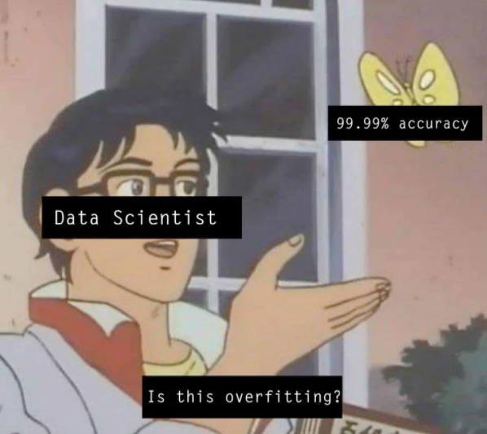
Agenda
Feature Engineering
Regression
Classification
Clustering
Modeling Techniques

Slide 46
Code Section 1: Feature Engineering
Week 9

Slide 47
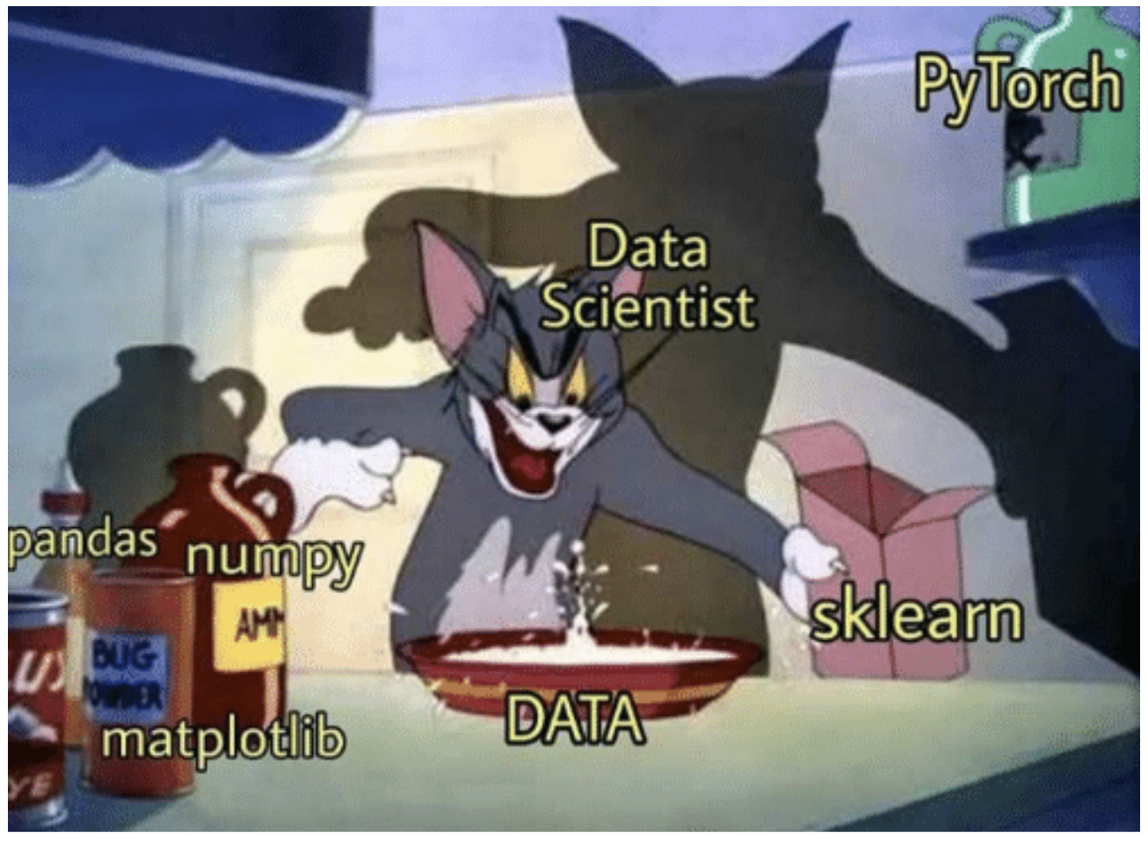
Feature Engineering
Feature engineering is the process of transforming raw data into features that better represent the underlying problem to the predictive models, resulting in improved model accuracy on unseen data. Feature engineering turn your inputs into things the algorithm can understand.
Notes:
Binning is a way to group a number of more or less continuous values into a smaller number of "bins". For example, if you have data about a group of people, you might want to arrange their ages into a smaller number of age intervals.

Slide 48
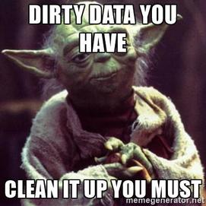
Feature Engineering
Using dummy variables
Feature scaling
Binning
Handling missing data
Merging data
Notes:
Feature engineering vs data engineering
Certain distribution
Drop data if entire column is missing
Dropping data by row = beware of losing too much info

Slide 49
Code Section 2: Regression
Week 9

Slide 50
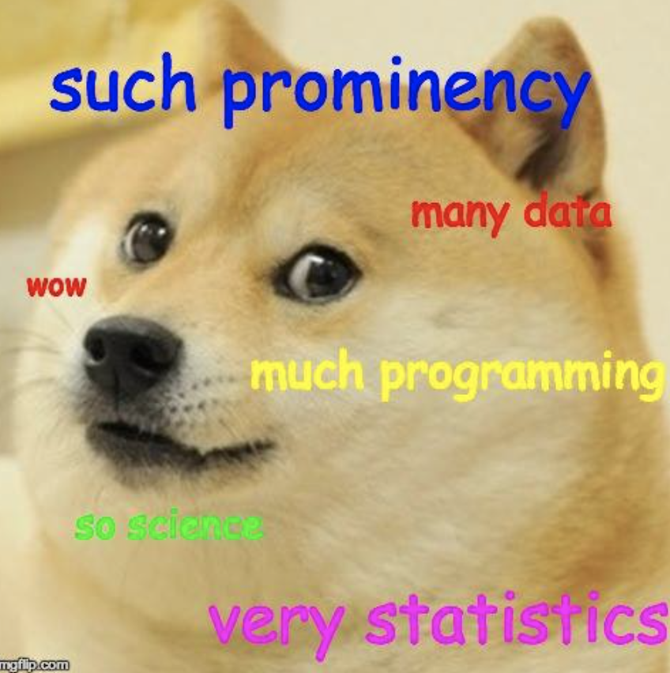
Regression
Regression analysis is a form of predictive modelling technique which investigates the relationship between a dependent (target) and independent variable/s (predictor). This technique is used for forecasting, time series modelling and finding the causal effect relationship between the variables
Outputs typically have a continuous value

Slide 51
Regression
Problems solved by regression
Simple linear regression
Simple multivariate regression
Metrics
Feature transformations
Advanced modeling techniques
Exercise: Prediction of the length of a salmon as a function of its age and weight

Slide 52
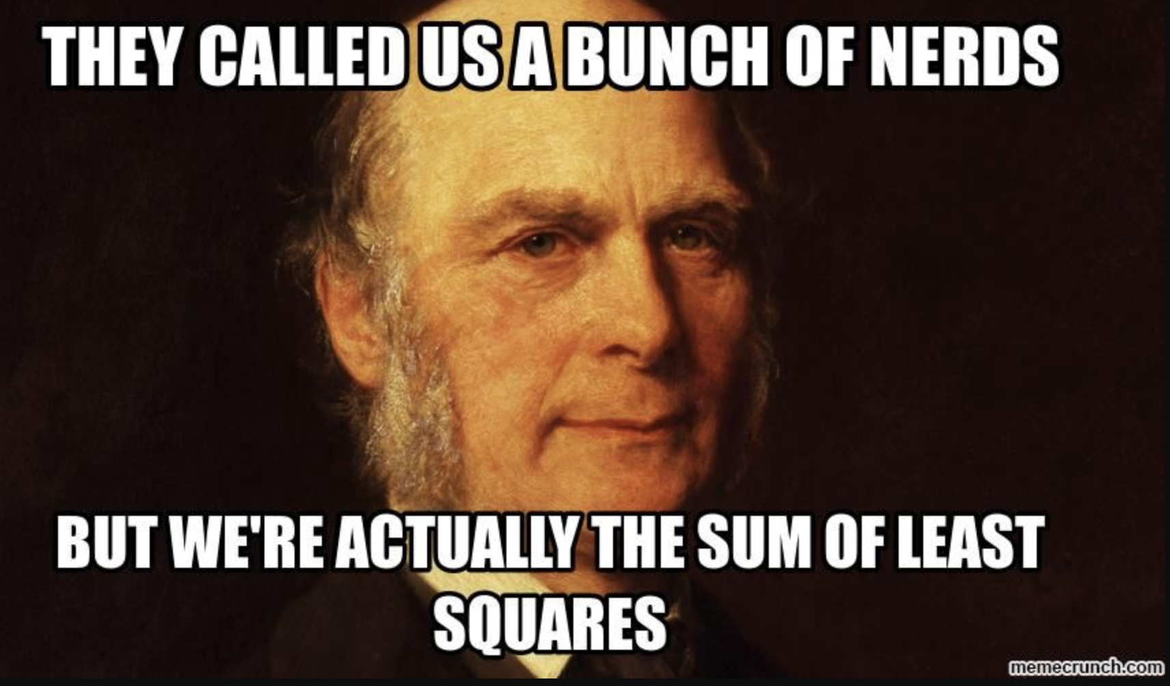
Problems Solved by Regression
Forecast future sales, demand, supply
Predicting house prices
Create a relationship between the features and the target (i.e. programmatic relationship between humidity and amount of rainfall to energy prices, relationship between advertising costs to sales, etc)
Francis Galton and the study of father-son height
Notes:
This all started in the 1800s
with a guy named Francis
Galton. Galton was studying
the relationship between
parents and their children. In
particular, he investigated the
relationship between the
heights of fathers and their
Sons.
What he discovered was that a
man's son tended to be
roughly as tall as his father.
However Galton's
breakthrough was that the
son's height tended to be
closer to the overall average
height of all people.
Let's take Shaquille O'Neal as an
example. Shaq is really tall:7ft 1in
(2.2 meters).
If Shaq has a son, chances are
he'll be pretty tall too. However,
Shaq is such an anomaly that
there is also a very good chance
that his son will be not be as tall
as Shaq.
Turns out this is the case:
Shaq's son is pretty tall (6 ft 7
in), but not nearly as tall as his
dad.
Galton called this
phenomenon regression, as in
"A father's son's height tends
to regress (or drift towards)
the mean (average) height."

Slide 53

Problems Solved by Regression
Forecast future sales, demand, supply
Extracting contribution charts—identifying numerical contributions of each feature towards predicting our target variable (i.e. Market Mix Modelling)
Create a relationship between the features and the target (i.e. programmatic relationship between humidity and amount of rainfall to energy prices, relationship between advertising costs to sales, etc)
Francis Galton and the study of father-son height
Notes:
This all started in the 1800s
with a guy named Francis
Galton. Galton was studying
the relationship between
parents and their children. In
particular, he investigated the
relationship between the
heights of fathers and their
Sons.
What he discovered was that a
man's son tended to be
roughly as tall as his father.
However Galton's
breakthrough was that the
son's height tended to be
closer to the overall average
height of all people.
Let's take Shaquille O'Neal as an
example. Shaq is really tall:7ft 1in
(2.2 meters).
If Shaq has a son, chances are
he'll be pretty tall too. However,
Shaq is such an anomaly that
there is also a very good chance
that his son will be not be as tall
as Shaq.
Turns out this is the case:
Shaq's son is pretty tall (6 ft 7
in), but not nearly as tall as his
dad.
Galton called this
phenomenon regression, as in
"A father's son's height tends
to regress (or drift towards)
the mean (average) height."

Slide 54
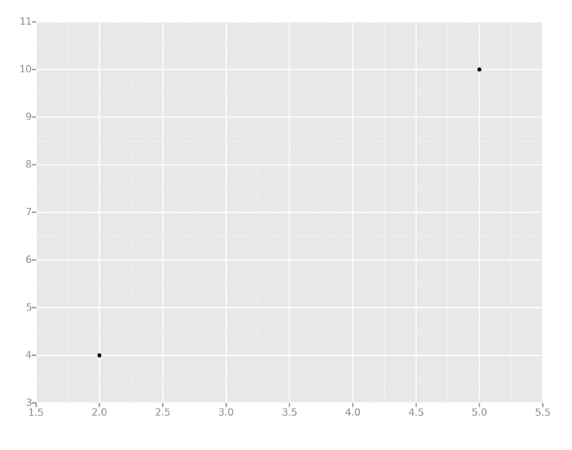
Simple Linear Regression
All we're trying to do when we
calculate our regression line is
draw a line that's as close to
every dot as possible.
Notes:
Let's take the simplest
possible example:
calculating a regression
with only 2 data points.

Slide 55
Simple Linear Regression
All we're trying to do when we
calculate our regression line is
draw a line that's as close to
every dot as possible.
Notes:
Let's take the simplest
possible example:
calculating a regression
with only 2 data points.

Slide 56
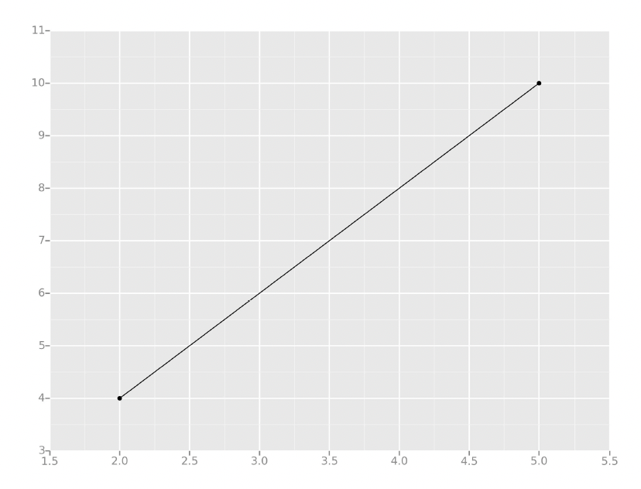
Simple Linear Regression
For classic linear regression, or
"Least Squares Method", you
only measure the closeness in
the "up and down" direction

Slide 57
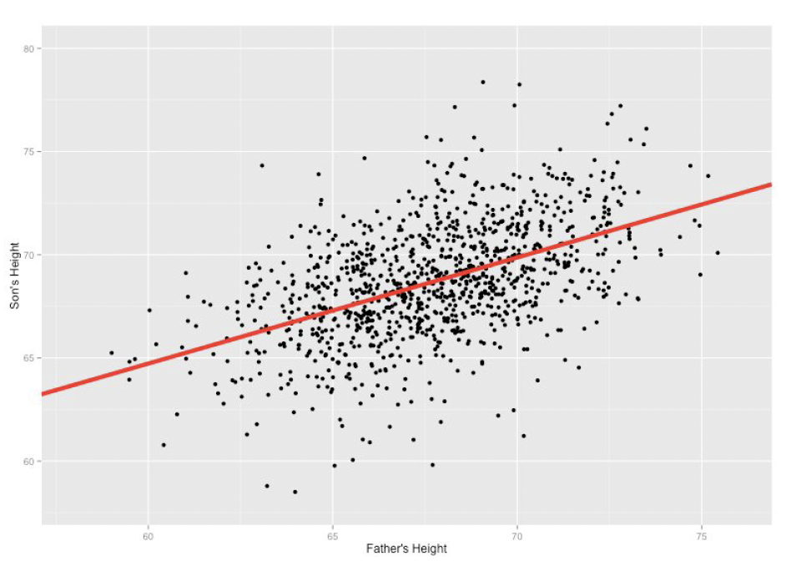
Simple Linear Regression
Our goal with linear regression
is to minimize the vertical
distance between all the data
points and our line.
So in determining the best line,
we are attempting to minimize
the distance between all the
points and their distance to
our line.
Notes:
Now wouldn't it be great if we
could apply this same concept to
a graph with more than just two
data points?
By doing this, we could take
multiple men and their son's
heights and do things like tell a
man how tall we expect his son to
be...before he even has a son!
There are lots of different
ways to minimize this, (sum of
squared errors, sum of
absolute errors, etc), but all
these methods have a general
goal of minimizing this
distance.

Slide 58
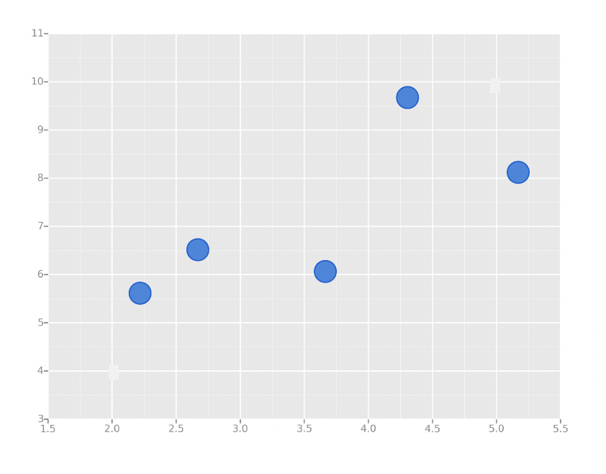
Simple Linear Regression
For example, one of the most
popular methods is the least
squares method.
Here we have blue data points
along an x and y axis.
Notes:
Now wouldn't it be great if we
could apply this same concept to
a graph with more than just two
data points?
By doing this, we could take
multiple men and their son's
heights and do things like tell a
man how tall we expect his son to
be...before he even has a son!
There are lots of different
ways to minimize this, (sum of
squared errors, sum of
absolute errors, etc), but all
these methods have a general
goal of minimizing this
distance.

Slide 59
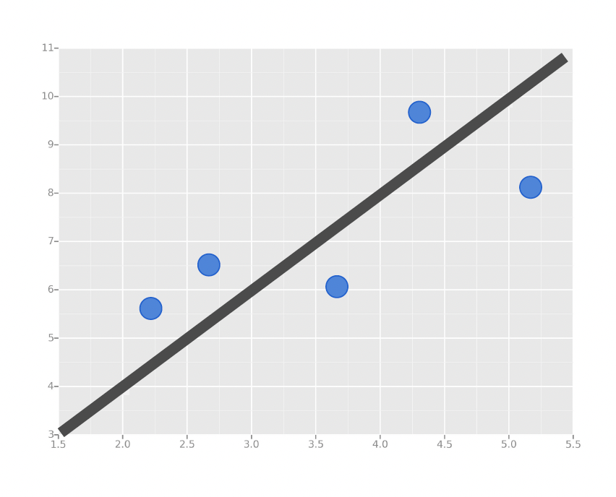
Simple Linear Regression
Now we want to fit a linear
regression line.
The question is, how do we
decide which line is the best
fitting one?
Notes:
Now wouldn't it be great if we
could apply this same concept to
a graph with more than just two
data points?
By doing this, we could take
multiple men and their son's
heights and do things like tell a
man how tall we expect his son to
be...before he even has a son!
There are lots of different
ways to minimize this, (sum of
squared errors, sum of
absolute errors, etc), but all
these methods have a general
goal of minimizing this
distance.

Slide 60
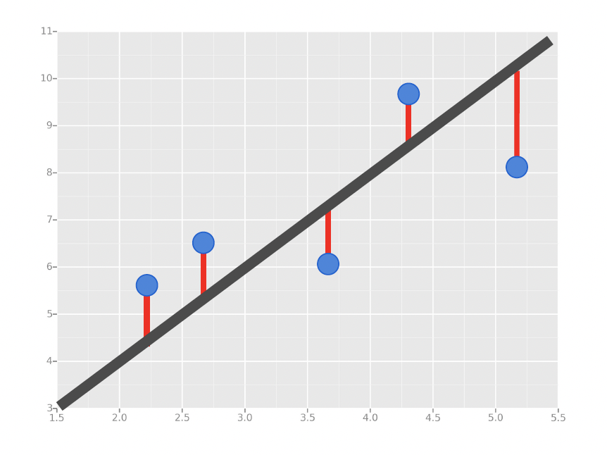
Simple Linear Regression
We’ll use the Least Squares
Method, which is fitted by
minimizing the sum of squares
of the residuals.
The residuals for an
observation is the difference
between the observation (the
y-value) and the fitted line.
Notes:
Here we have a couple of blue data points along an x and y axes and we want to fit a linear regression
line.
And the question is how do we decide which line is the best fitting one we can go ahead and use the
least squares method which we discussed earlier.
This method is fitted by minimizing the sum of the squares of the residuals the residuals for an observation
is the difference between the observation the y value and the fitted line.
In this image the residuals are marked by the red line.
The difference between the true data point in blue and your fitted model line.
Black diagonal line

Slide 61
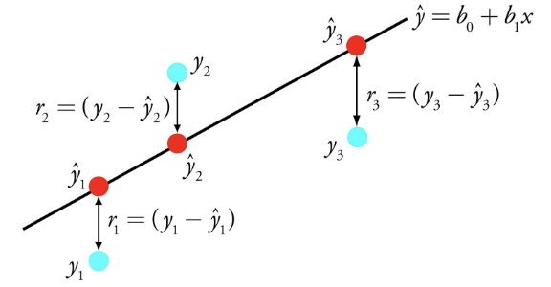
Simple Linear Regression
The term “linearity” in algebra refers to a linear relationship between two or more variables.
If we draw this relationship in a two-dimensional space (between two variables), we get a straight line.

Slide 62
Simple Linear Regression
Performs the task to predict a dependent variable (y) based on a given independent variable (x). So, this regression technique finds out a linear relationship between x (input) and y (output).

Slide 63
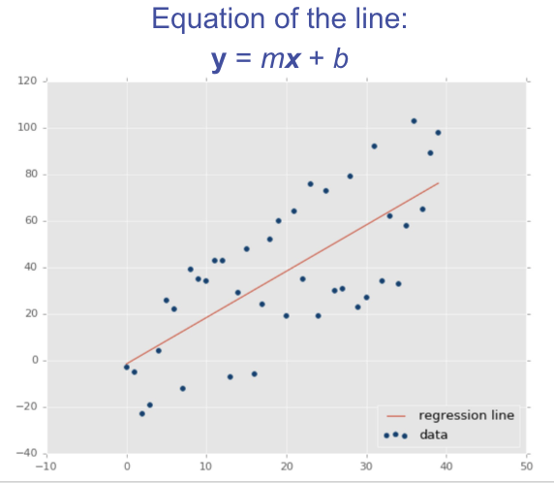
Simple Linear Regression

Slide 64
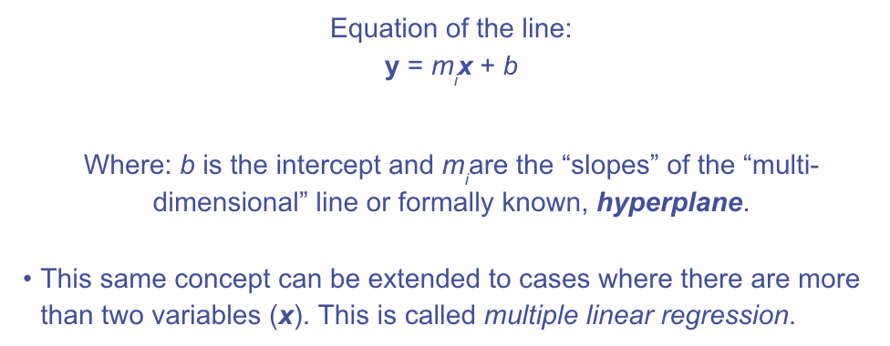
Simple Linear Regression

Slide 65
Simple Linear Regression: Model Evaluation
Regression is a task when a model attempts to predict continuous values (unlike categorical values, which is classification) so we need evaluation metrics designed for continuous values
Example:
Attempting to predict the price of a house given its features is a regression task.
Attempting to predict the country a house is in given its features would be a classification task.
Let’s discuss some of the most common evaluation metrics for regression:
Mean Absolute Error
Mean Squared Error
Root Mean Square Error
Notes:
Let’s take a moment now to discuss evaluating Regression Models
Regression is a task when a model attempts to predict continuous values (unlike categorical values, which is classification)
You may have heard of some evaluation metrics like accuracy or recall.
These sort of metrics aren’t useful for regression problems, we need metrics designed for continuous values!

Slide 66
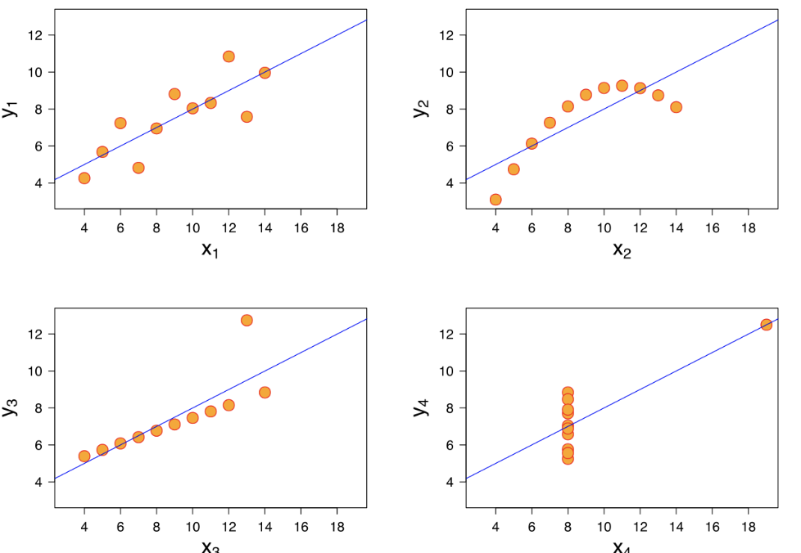

Simple Linear Regression: Model Evaluation
Mean Absolute Error (MAE)
This is the mean of the absolute value of errors.
Easy to understand
MAE won’t punish large errors
We want our error metrics to account for these!
Notes:
Let’s take a moment now to discuss evaluating Regression Models
Regression is a task when a model attempts to predict continuous values (unlike categorical values, which is classification)
You may have heard of some evaluation metrics like accuracy or recall.
These sort of metrics aren’t useful for regression problems, we need metrics designed for continuous values!

Slide 67

Simple Linear Regression: Model Evaluation

Slide 68

Simple Linear Regression: Model Evaluation

Slide 69

Simple Linear Regression: Model Evaluation
Mean Squared Error (MSE)
This is the mean of the squared errors.
Larger errors are noted more than with MAE, making MSE more popular.
Notes:
Let’s take a moment now to discuss evaluating Regression Models
Regression is a task when a model attempts to predict continuous values (unlike categorical values, which is classification)
You may have heard of some evaluation metrics like accuracy or recall.
These sort of metrics aren’t useful for regression problems, we need metrics designed for continuous values!

Slide 70

Simple Linear Regression: Model Evaluation
Notes:
Let’s analyze what this equation actually means.
In mathematics, the character that looks like weird E is called summation (Greek sigma). It is the sum of a sequence of numbers, from i=1 to n. Let’s imagine this like an array of points, where we go through all the points, from the first (i=1) to the last (i=n).
For each point, we take the y-coordinate of the point, and the y’-coordinate. The y-coordinate is our purple dot. The y’ point sits on the line we created. We subtract the y-coordinate value from the y’-coordinate value, and calculate the square of the result.
The third part is to take the sum of all the (y-y’)² values, and divide it by n, which will give the mean.
Our goal is to minimize this mean, which will provide us with the best line that goes through all the points.

Slide 71

Simple Linear Regression: Model Evaluation

Slide 72

Simple Linear Regression: Model Evaluation
Root Mean Square Error (RMSE)
This is the root of the mean of the squared errors.
Most popular (has same units as y)
Common question: “Is this value of RMSE good?”
Context is everything!
A RMSE of $10 is fantastic for predicting the price of a house, but horrible for predicting the price of a candy bar!
Notes:
Compare your error metric to the average value of the label in your data set to try to get an intuition of its overall performance.
Domain knowledge also plays an important role here!
Context of importance is also necessary to consider.
We may create a model to predict how much medication to give, in which case small fluctuations in RMSE may actually be very significant.
Root Mean Square Error (RMSE) is the standard deviation of the residuals (prediction errors). Residuals are a measure of how far from the regression line data points are; RMSE is a measure of how spread out these residuals are. In other words, it tells you how concentrated the data is around the line of best fit. Root mean square error is commonly used in climatology, forecasting, and regression analysis to verify experimental results.

Slide 73

Simple Linear Regression: Model Evaluation

Slide 74
Code Section 3: Classification
Week 9

Slide 75

Classification
Samples belong to two or more classes and we want to learn from already labeled data how to predict the class of unlabeled data. An example of a classification problem would be handwritten digit recognition, in which the aim is to assign each input vector to one of a finite number of discrete categories. Another way to think of classification is as a discrete (as opposed to continuous) form of supervised learning where one has a limited number of categories and for each of the n samples provided, one is to try to label them with the correct category or class.

Slide 76
Classification
Problems solved by Classification
Simple Classification Techniques - Logistic Regression
Classification Metrics
Model-Based Feature Selection
Advance Modelling Techniques
Notes:
ISLR Section 4
Logistic regression as a method for classification
What categories things belong to

Slide 77
Problems Solved by Classification
We want to learn about Logistic Regression as a method for Classification.
Some examples of classification problems:
Spam versus “Ham” emails
Loan Default (yes/no)
Disease Diagnosis
Above were all examples of Binary Classification
Disease detection (cardiovascular, sleep, etc),
Image recognition, image segmentation, object detection,
Click-through prediction, churn modelling.
Fraud detection (credit cards, etc),
Event prediction (predict next app use case, predict next website click)
Although the name may be confusing at first, logistic regression allows us to solve classification problems, where we are trying to predict discrete categories.
The convention for binary classification is to have two classes 0 and 1.
Notes:
● So far we’ve only seen regression problems where we try to
predict a continuous value. (price of a house)
● Although the name may be confusing at first, logistic
regression allows us to solve classification problems, where
we are trying to predict discrete categories.
● The convention for binary classification is to have two
classes 0 and 1.

Slide 78

Logistic Regression
We can’t use a normal linear regression model on binary groups. It won’t lead to a good fit.
Notes:
Y axis represents the probability of belonging to a certain group
Imagine that this example plot is trying to predict the probability / likelihood of paying back a loan
0% probability is defaulting on the loan (meaning 0% probability of paying back the loan)
X axis = paycheck value
As your paycheck goes lower, you have lower likelihood of paying back your loans
Yellow dashes = training data

Slide 79

Logistic Regression
Notes:
Instead we can transform our linear regression to a logistic
regression curve.
Logistic regression curve can only go from 0 or 1
Sigmoid = logistic function

Slide 80

Logistic Regression
The Sigmoid (aka Logistic) Function takes in any value and outputs it to be between 0 and 1
This means we can take our Linear Regression Solution and place it into the Sigmoid Function
Notes:
The key secret to this function is that it can take in any value and its output is going to be between 0 and 1.
Instead we can transform our linear regression to a logistic regression curve.

Slide 81

Logistic Regression
The Sigmoid (aka Logistic) Function takes in any value and outputs it to be between 0 and 1
This means we can take our Linear Regression Solution and place it into the Sigmoid Function
Notes:
This results in a probability from 0 to 1 of belonging in the 1
class.
This means that we can take her linear regression solution and place it into this sigmoid function and
that's going to look like this.
Remember our linear model followed a basic y equals x plus B principle.
Here we have a linear model as y equals beta plus Beta 1 times X..
If we take that linear model and put it into the sigmoid function we finally are able to transform this
linear regression to a logistic model meaning it doesn't matter whatever the value of the linear model
output actually is.
It's always going to be between 0 and 1 when we place it into the logistic model or the sigmoid function

Slide 82

Logistic Regression
We use the logistic function to output a value ranging from 0 to 1. Based off of this probability we assign a class.
We can set a cutoff point at 0.5, anything below it results in class 0, anything above is class 1
Notes:
This results in a probability from 0 to 1 of belonging in the 1
class.

Slide 83

Logistic Regression
Easy to implement and can be used as the baseline for any binary classification problem.

Slide 84

Logistic Regression

Slide 85

Logistic Regression: Model Evaluation
Notes:
● After you train a logistic regression model on some training
data, you will evaluate your model’s performance on some
test data.
● You can use a confusion matrix to evaluate classification
models.

Slide 86

Logistic Regression: Model Evaluation
Notes:
Let's go ahead and walk through this example.
In this case we have a binary classification problem.
So in this example we're testing for the presence of a disease where no is a negative test which is
false equals zero.
Yes is a positive test where true is equal to one.
What can we learn from this matrix.
Well there are two possible predicted classes.
Yes and no.
If we were predicting the presence of a disease for example yes it would mean that they have disease
.
No it would mean that they don't have disease.
The classifier made a total of a hundred and sixty five predictions meaning 165 patients were tested
for the presence of the disease.
Out of those 165 cases the classifier predicted a yes 110 times and no.
Fifty five times.
In reality meaning we already have label test data 105 patients in the sample have the disease and 60
patients do not.

Slide 87

Logistic Regression: Model Evaluation
Notes:
Let's go ahead and walk through this example.
In this case we have a binary classification problem.
So in this example we're testing for the presence of a disease where no is a negative test which is
false equals zero.
Yes is a positive test where true is equal to one.
What can we learn from this matrix.
Well there are two possible predicted classes.
Yes and no.
If we were predicting the presence of a disease for example yes it would mean that they have disease
.
No it would mean that they don't have disease.
The classifier made a total of a hundred and sixty five predictions meaning 165 patients were tested
for the presence of the disease.
Out of those 165 cases the classifier predicted a yes 110 times and no.
Fifty five times.
In reality meaning we already have label test data 105 patients in the sample have the disease and 60
patients do not.

Slide 88

Logistic Regression: Model Evaluation
Notes:
● After you train a logistic regression model on some training
data, you will evaluate your model’s performance on some
test data.
● You can use a confusion matrix to evaluate classification
models.

Slide 89

Logistic Regression: Model Evaluation
Notes:
● After you train a logistic regression model on some training
data, you will evaluate your model’s performance on some
test data.
● You can use a confusion matrix to evaluate classification
models.

Slide 90

Logistic Regression: Model Evaluation
Notes:
● After you train a logistic regression model on some training
data, you will evaluate your model’s performance on some
test data.
● You can use a confusion matrix to evaluate classification
models.

Slide 91

Logistic Regression: Model Evaluation
Notes:
● After you train a logistic regression model on some training
data, you will evaluate your model’s performance on some
test data.
● You can use a confusion matrix to evaluate classification
models.

Slide 92

Logistic Regression: Model Evaluation
Notes:
● After you train a logistic regression model on some training
data, you will evaluate your model’s performance on some
test data.
● You can use a confusion matrix to evaluate classification
models.

Slide 93

Logistic Regression: Model Evaluation
Notes:
● After you train a logistic regression model on some training
data, you will evaluate your model’s performance on some
test data.
● You can use a confusion matrix to evaluate classification
models.

Slide 94
Code Section 4: Clustering
Week 9

Slide 95

Clustering
Cluster analysis or clustering is the task of grouping a set of objects in such a way that objects in the same group (called a cluster) are more similar (in some sense) to each other than to those in other groups (clusters). It is a main task of exploratory data mining, and a common technique for statistical data analysis, used in many fields, including pattern recognition, image analysis, information retrieval, bioinformatics, data compression, computer graphics and machine learning.

Slide 96
Clustering
Problems solved by Clustering
Simple Clustering Techniques
Choosing Clusters
Advanced Modelling Techniques

Slide 97

Problems Solved by Clustering

Slide 98

Problems Solved by Clustering
Fake news detection
Label-less fraud detection
Spam filtering
Document analysis

Slide 99
K-Means Clustering
K Means Clustering is an unsupervised learning algorithm that will attempt to group similar clusters together in your data.
So what does a typical clustering problem look like?
● Cluster Similar Documents
● Cluster Customers based on Features
● Market Segmentation
● Identify similar physical groups
Notes:
ISLR Ch10
Unlabeled data

Slide 100

K-Means Clustering
The overall goal is to divide data into distinct groups such that observations within each group are similar
Notes:
Here you can see a diagram of unlabelled training data and k means clustering trying to attempt to cluster
that data into five distinct clock colored clusters here.

Slide 101
K-Means Clustering
The K Means Algorithm
● Choose a number of Clusters “K”
● Randomly assign each point to a cluster
● Until clusters stop changing, repeat the following:
○ For each cluster, compute the cluster centroid by
taking the mean vector of points in the cluster
○ Assign each data point to the cluster for which the
centroid is the closest
Notes:
How does the algorithm actually work.
Well you first choosing a number of clusters K and we'll discuss how to choose k later on then you randomly
assign each point in your data to a specific cluster then until the clusters stop changing.
You repeat the following steps for each cluster you're going to compute the cluster centroid by taking
the mean vector points in the cluster.
Then you assign each data point to the cluster for which the centroid is the closest.
Let's go ahead and take a look at the state of visualization or this plotted out visualization of k

Slide 102

K-Means Clustering
Notes:
You first start off with just the observations that's shown on the top left then in top center we have
Step 1 of the algorithm.
Each observation is randomly assigned to a cluster in the top right of step 2 A The cluster centroid
are then computed.
These are shown as large colored disks.
Initially these centroid are almost completely overlapping because the initial cluster assignments were
chosen at random in the bottom left.
And step two be each observation is assigned to the nearest centroid in the bottom center.
Step two is once again perform and you can see that we've led to a new cluster centroid and we basically
keep repeating these steps until there's no new clusters meaning data points aren't being reassigned
to a new cluster centroid at the bottom right.
We have the results obtained after about 10 iterations.

Slide 103

K-Means Clustering
Notes:
Let's discuss choosing a k value as we just saw to perform k means clustering.
We have to decide how many clusters we expect in the data.
The problem of selecting K isn't actually that simple.
There is no easy answer for choosing a best case value.

Slide 104
K-Means Clustering
There is no easy answer for choosing a “best” K value
One way is the elbow method
First of all, compute the sum of squared error (SSE) for some values of k (for example 2, 4, 6, 8, etc.).
The SSE is defined as the sum of the squared distance between each member of the cluster and its centroid.
If you plot k against the SSE, you will see that the error decreases as k gets larger; this is because when the number of clusters increases, they should be smaller, so distortion is also smaller.
The idea of the elbow method is to choose the k at which the SSE decreases abruptly.
This produces an "elbow effect" in the graph, as you can see in the following picture:

Slide 105

K-Means Clustering

Slide 106
Code Section 5: Deployment
Week 10

Slide 107

Modeling Techniques
Now that we've gone through the basics, we'll showcase a few techniques that can be used to further improve your model development workflow–in particular, we will discuss deployment methods
Ad Sales Prediction
Web Deployment
Insurance App Training
Create an API Using Fast API

Slide 108

Streamlit
Streamlit turns data scripts into shareable web apps in minutes all in pure Python
It’s a quick way to build ML web apps without worrying about frontend.
Streamlit examples:
BERT Keyword Extractor
Speech to Text App
SpaCy

Slide 109


FastAPI
FastAPI is a modern, fast (high-performance), web framework for building APIs with Python 3.6+ based on standard Python type hints.
Getting Started:
Your First App
First Steps
Hello, World
Hello, World Docs

Slide 110
Thank you :)

